Slide 1
WATER QUALITY ASSESSMENT THROUGH REMOTE SENSING TECHNIQUES
FOR MADURAI CITY,TAMILNADU

Slide 2
OBJECTIVE
To develop a relationship Model between water quality parameters (WQP) and remotely sensed data (RSD).
REMOTE SENSING & GIS LAB, Dept. of ECE,TCE

Slide 3
Water quality is a general descriptor of water properties in terms of physical, chemical, thermal, and/or biological characteristics.
It is difficult to define a single water quality standard to meet all uses and user needs.
  pH
  Chemical Oxygen Demand (mg/l)
  Total Dissolved Solids (mg/l)
  Dissolved Oxygen (mg/l)
  Hardness (mg/l)
REMOTE SENSING & GIS LAB, Dept. of ECE,TCE

Slide 4
Reflectance value of samples of different bands
Samp.no | Blue | Green | Red | NIR | MIR
1 | 68 | 49 | 39 | 19 | 18
2 | 70 | 51 | 41 | 23 | 24
3 | 73 | 55 | 44 | 21 | 19
4 | 68 | 50 | 39 | 20 | 21
5 | 73 | 61 | 49 | 19 | 14
6 | 74 | 62 | 50 | 19 | 13
7 | 72 | 62 | 49 | 19 | 14
8 | 75 | 60 | 50 | 22 | 33
9 | 73 | 59 | 45 | 21 | 13
10 | 75 | 59 | 47 | 27 | 18
11 | 73 | 62 | 49 | 19 | 13
12 | 72 | 62 | 50 | 22 | 14
13 | 74 | 59 | 46 | 24 | 14
14 | 74 | 59 | 47 | 21 | 14
15 | 68 | 52 | 39 | 17 | 12
16 | 68 | 51 | 37 | 16 | 12
17 | 68 | 52 | 40 | 17 | 12
REMOTE SENSING & GIS LAB, Dept. of ECE,TCE

Slide 5
contd
Samp.no | Blue | Green | Red | NIR | MIR
18 | 68 | 52 | 40 | 17 | 12
19 | 69 | 52 | 41 | 20 | 13
20 | 69 | 52 | 41 | 20 | 13
21 | 67 | 51 | 39 | 18 | 14
22 | 67 | 54 | 39 | 18 | 13
23 | 69 | 52 | 40 | 18 | 14
24 | 69 | 53 | 41 | 28 | 24
25 | 68 | 52 | 41 | 27 | 27
26 | 70 | 52 | 41 | 27 | 27
27 | 70 | 53 | 45 | 31 | 24
28 | 70 | 54 | 43 | 35 | 27
29 | 69 | 55 | 52 | 36 | 37
30 | 71 | 58 | 49 | 32 | 27
31 | 70 | 54 | 46 | 37 | 38
32 | 67 | 51 | 40 | 32 | 26
33 | 68 | 54 | 40 | 17 | 14
34 | 69 | 53 | 40 | 17 | 15

Slide 6
Water quality parameters for each samples
Samp.no | pH | COD(mg/l) | TDS(mg/l) | DO(mg/l) | Hardness(mg/l)
1 | 8.03 | 64 | 345 | 4.2 | 232
2 | 7.72 | 20 | 338 | 2.3 | 212
3 | 7.86 | 20 | 340 | 5.7 | 188
4 | 7.81 | 48 | 318 | 5.8 | 212
5 | 8.13 | 48 | 545 | 4.8 | 252
6 | 8.28 | 12 | 550 | 3.1 | 284
7 | 8.23 | 104 | 548 | 5.7 | 292
8 | 7.93 | 4 | 651 | 3.7 | 236
9 | 8.19 | 68 | 595 | 4.3 | 156
10 | 7.94 | 100 | 560 | 4.8 | 312
11 | 8.24 | 40 | 597 | 2.5 | 316
12 | 8.23 | 20 | 621 | 2.8 | 300
13 | 8.27 | 100 | 621 | 3.2 | 332
14 | 8.27 | 12 | 614 | 3.5 | 324
15 | 8.91 | 88 | 350 | 6.9 | 208
16 | 8.64 | 88 | 345 | 7.8 | 200
17 | 8.63 | 100 | 350 | 8.3 | 212

Slide 7
Contd..
Samp.no | pH | COD(mg/l) | TDS(mg/l) | DO(mg/l) | Hardness(mg/l)
18 | 8.61 | 84 | 348 | 7.5 | 192
19 | 8.59 | 84 | 352 | 7.2 | 200
20 | 8.65 | 88 | 350 | 7.1 | 192
21 | 8.60 | 72 | 350 | 7.1 | 188
22 | 8.63 | 88 | 350 | 6.1 | 204
23 | 8.68 | 16 | 349 | 7.8 | 196
24 | 8.60 | 96 | 351 | 7.2 | 204
25 | 8.52 | 36 | 296 | 5.1 | 184
26 | 8.20 | 80 | 300 | 5.0 | 163
27 | 8.19 | 32 | 302 | 5.0 | 180
28 | 8.27 | 24 | 298 | 4.3 | 145
29 | 8.23 | 140 | 301 | 5.9 | 132
30 | 8.26 | 28 | 294 | 4.7 | 156
31 | 8.21 | 16 | 298 | 4.6 | 152
32 | 8.24 | 20 | 297 | 4.5 | 140
33 | 8.28 | 8 | 296 | 4.5 | 140
34 | 8.26 | 16 | 301 | 3.4 | 148

Slide 8
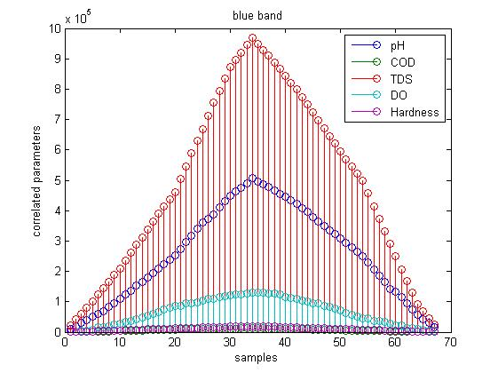
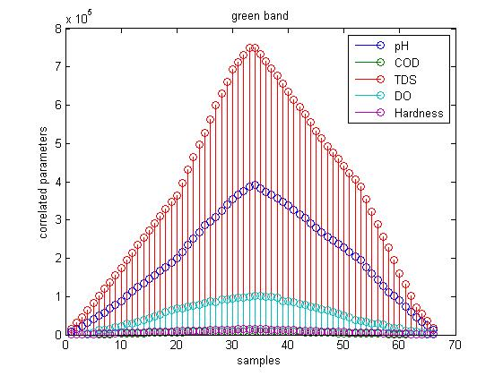
Correlation between various bands and WQPs
Blue band
Green band
REMOTE SENSING & GIS LAB, Dept. of ECE,TCE

Slide 9
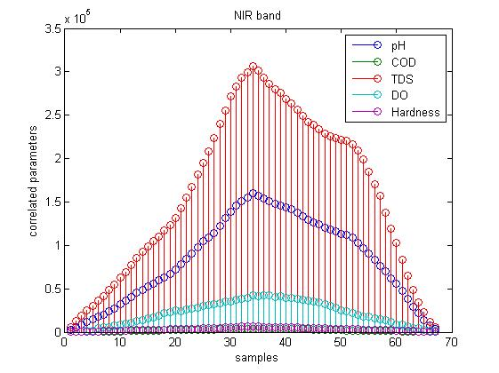
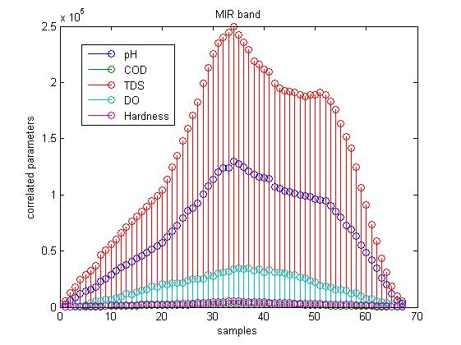
contd
Near IR
Mid IR
REMOTE SENSING & GIS LAB, Dept. of ECE,TCE

Slide 10
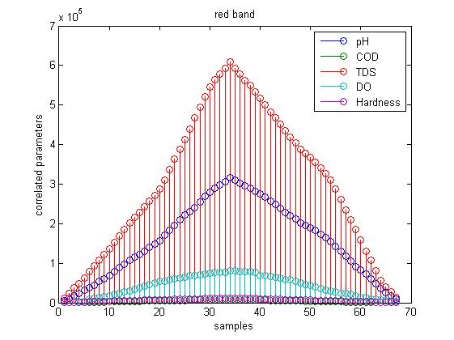

Contd
Red band
Thermal IR
REMOTE SENSING & GIS LAB, Dept. of ECE,TCE

Slide 11
contd
 | BLUE | GREEN | RED | NIR | TIR | MIR
TDS | 9.70E+05 | 6.97E+05 | 6.08E+05 | 3.07E+05 | 1.92E+05 | 2.50E+05
pH | 5.07E+05 | 3.66E+05 | 3.16E+05 | 1.60E+05 | 1.00E+05 | 1.30E+05
DO | 1.31E+05 | 9.91E+04 | 8.04E+04 | 4.21E+04 | 2.62E+04 | 3.37E+04
Hardness | 1.98E+04 | 1.38E+04 | 1.23E+04 | 6.43E+03 | 4.05E+03 | 5.31E+03
COD | 1.23E+04 | 8.77E+03 | 7.55E+03 | 3.95E+03 | 2.48E+03 | 3.25E+03
REMOTE SENSING & GIS LAB, Dept. of ECE,TCE

Slide 12
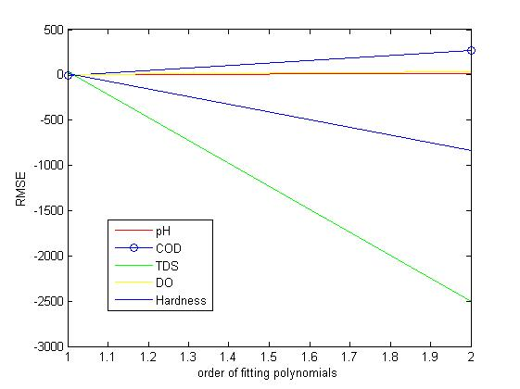
Results
REMOTE SENSING & GIS LAB, Dept. of ECE,TCE

Slide 13
pH – Data Fitting Comparison
S.NO | GREY VALUE (BLUE BAND) | pH |  | DIFFERENCE
 |  | MANUAL OUTPUT | FITTED OUTPUT
1 | 68 | 8.03 | 8.4301 | 0.4001
2 | 70 | 7.72 | 8.3171 | 0.5971
3 | 73 | 7.86 | 8.1477 | 0.2877
4 | 68 | 7.81 | 8.4301 | 0.6201
5 | 73 | 8.13 | 8.1477 | 0.0177
6 | 74 | 8.28 | 8.0912 | 0.1888
7 | 72 | 8.23 | 8.2042 | 0.0258
8 | 75 | 7.93 | 8.0347 | 0.1047
9 | 73 | 8.19 | 8.1477 | 0.0423
10 | 75 | 7.94 | 8.0347 | 0.0947
11 | 73 | 8.24 | 8.1477 | 0.0923
12 | 72 | 8.23 | 8.2042 | 0.0258
13 | 74 | 8.27 | 8.0912 | 0.1788
14 | 74 | 8.27 | 8.0912 | 0.1788
15 | 68 | 8.91 | 8.4301 | 0.4799
16 | 68 | 8.64 | 8.4301 | 0.2099
17 | 68 | 8.63 | 8.4301 | 0.1999
18 | 68 | 8.61 | 8.4301 | 0.1799
S.NO | GREY VALUE (BLUE BAND) | pH |  | DIFFERENCE
 |  | MANUAL OUTPUT | FITTED OUTPUT
19 | 69 | 8.59 | 8.3736 | 0.2164
20 | 69 | 8.65 | 8.3736 | 0.2764
21 | 67 | 8.60 | 8.4865 | 0.1135
22 | 67 | 8.63 | 8.4865 | 0.1435
23 | 69 | 8.68 | 8.3736 | 0.3064
24 | 69 | 8.60 | 8.3736 | 0.2264
25 | 68 | 8.52 | 8.4301 | 0.0899
26 | 70 | 8.20 | 8.3171 | 0.1171
27 | 70 | 8.19 | 8.3171 | 0.1271
28 | 70 | 8.27 | 8.3171 | 0.0471
29 | 69 | 8.23 | 8.3736 | 0.1436
30 | 71 | 8.26 | 8.2606 | 0.0006
31 | 70 | 8.21 | 8.3171 | 0.1071
32 | 67 | 8.24 | 8.4865 | 0.2465
33 | 68 | 8.28 | 8.4301 | 0.1501
34 | 69 | 8.26 | 8.3736 | 0.1136

Slide 14
COD – Data Fitting Comparison
S.NO | GREY VALUE (BLUE BAND) | COD |  | DIFFERENCE
 |  | MANUAL OUTPUT | FITTED OUTPUT
1 | 68 | 64 | 61.6621 | 2.3379
2 | 70 | 20 | 55.5434 | 35.5434
3 | 73 | 20 | 46.3653 | 26.3653
4 | 68 | 48 | 61.6621 | 13.6621
5 | 73 | 48 | 46.3653 | 1.6347
6 | 74 | 12 | 43.3059 | 31.3059
7 | 72 | 104 | 49.4247 | 54.5753
8 | 75 | 4 | 40.2466 | 36.2466
9 | 73 | 68 | 46.3653 | 21.6347
10 | 75 | 100 | 40.2466 | 59.7534
11 | 73 | 40 | 46.3653 | 6.3653
12 | 72 | 20 | 49.4247 | 29.4247
13 | 74 | 100 | 43.3059 | 56.6941
14 | 74 | 12 | 43.3059 | 31.3059
15 | 68 | 88 | 61.6621 | 26.3379
16 | 68 | 88 | 61.6621 | 26.3379
17 | 68 | 100 | 61.6621 | 38.3379
S.NO | GREY VALUE (BLUE BAND) | COD |  | DIFFERENCE
 |  | MANUAL OUTPUT | FITTED OUTPUT
18 | 68 | 84 | 61.6621 | 22.3379
19 | 69 | 84 | 58.6027 | 25.3973
20 | 69 | 88 | 58.6027 | 29.3973
21 | 67 | 72 | 64.7215 | 7.2785
22 | 67 | 88 | 64.7215 | 23.2785
23 | 69 | 16 | 58.6027 | 42.6027
24 | 69 | 96 | 58.6027 | 37.3973
25 | 68 | 36 | 61.6621 | 25.6621
26 | 70 | 80 | 55.5434 | 24.4566
27 | 70 | 32 | 55.5434 | 23.5434
28 | 70 | 24 | 55.5434 | 31.5434
29 | 69 | 140 | 58.6027 | 81.3973
30 | 71 | 28 | 52.4840 | 24.4840
31 | 70 | 16 | 55.5434 | 39.5434
32 | 67 | 20 | 64.7215 | 44.7215
33 | 68 | 8 | 61.6621 | 53.6621
34 | 69 | 16 | 58.6027 | 42.6027

Slide 15
TDS – Data Fitting Comparison
S.NO | GREY VALUE (BLUE BAND) | TDS |  | DIFFERENCE
 |  | MANUAL OUTPUT | FITTED OUTPUT
1 | 68 | 345 | 310.9606 | 34.0394
2 | 70 | 338 | 393.8116 | 55.8116
3 | 73 | 340 | 518.0882 | 178.0882
4 | 68 | 318 | 310.9606 | 7.0394
5 | 73 | 545 | 518.0882 | 26.9118
6 | 74 | 550 | 559.5137 | 9.5137
7 | 72 | 548 | 476.6627 | 71.3373
8 | 75 | 651 | 600.9392 | 50.0608
9 | 73 | 595 | 518.0882 | 76.9118
10 | 75 | 560 | 600.9392 | 40.9392
11 | 73 | 597 | 518.0882 | 78.9118
12 | 72 | 621 | 476.6627 | 144.3373
13 | 74 | 621 | 559.5137 | 61.4863
14 | 74 | 614 | 559.5137 | 54.4863
15 | 68 | 350 | 310.9606 | 39.0394
16 | 68 | 345 | 310.9606 | 34.0394
17 | 68 | 350 | 310.9606 | 39.0394
S.NO | GREY VALUE (BLUE BAND) | TDS |  | DIFFERENCE
 |  | MANUAL OUTPUT | FITTED OUTPUT
18 | 68 | 348 | 310.9606 | 37.0394
19 | 69 | 352 | 352.3861 | 0.3861
20 | 69 | 350 | 352.3861 | 2.3861
21 | 67 | 350 | 269.5351 | 80.4649
22 | 67 | 350 | 269.5351 | 80.4649
23 | 69 | 349 | 352.3861 | 3.3861
24 | 69 | 351 | 352.3861 | 1.3861
25 | 68 | 296 | 310.9606 | 14.9606
26 | 70 | 300 | 393.8116 | 93.8116
27 | 70 | 302 | 393.8116 | 91.8116
28 | 70 | 298 | 393.8116 | 95.8116
29 | 69 | 301 | 352.3861 | 51.3861
30 | 71 | 294 | 435.2372 | 141.2372
31 | 70 | 298 | 393.8116 | 95.8116
32 | 67 | 297 | 269.5351 | 27.4649
33 | 68 | 296 | 310.9606 | 14.9606
34 | 69 | 301 | 352.3861 | 51.3861

Slide 16
DO – Data Fitting Comparison
S.NO | GREY VALUE (BLUE BAND) | DO |  | DIFFERENCE
 |  | MANUAL OUTPUT | FITTED OUTPUT
1 | 68 | 4.2 | 6.0353 | 1.8353
2 | 70 | 2.3 | 5.2774 | 2.9774
3 | 73 | 5.7 | 4.1406 | 1.5594
4 | 68 | 5.8 | 6.0353 | 0.2353
5 | 73 | 4.8 | 4.1406 | 0.6594
6 | 74 | 3.1 | 3.7616 | 0.6616
7 | 72 | 5.7 | 4.5195 | 1.1805
8 | 75 | 3.7 | 3.3827 | 0.3173
9 | 73 | 4.3 | 4.1406 | 0.1594
10 | 75 | 4.8 | 3.3827 | 1.4173
11 | 73 | 2.5 | 4.1406 | 1.6406
12 | 72 | 2.8 | 4.5195 | 1.7195
13 | 74 | 3.2 | 3.7616 | 0.5616
14 | 74 | 3.5 | 3.7616 | 0.2616
15 | 68 | 6.9 | 6.0353 | 0.8647
16 | 68 | 7.8 | 6.0353 | 1.7647
17 | 68 | 8.3 | 6.0353 | 2.2647
S.NO | GREY VALUE (BLUE BAND) | DO |  | DIFFERENCE
 |  | MANUAL OUTPUT | FITTED OUTPUT
18 | 68 | 7.5 | 6.0353 | 1.4647
19 | 69 | 7.2 | 5.6563 | 1.5437
20 | 69 | 7.1 | 5.6563 | 1.4437
21 | 67 | 7.1 | 6.4142 | 0.6858
22 | 67 | 6.1 | 6.4142 | 0.3142
23 | 69 | 7.8 | 5.6563 | 2.1437
24 | 69 | 7.2 | 5.6563 | 1.5437
25 | 68 | 5.1 | 6.0353 | 0.9353
26 | 70 | 5.0 | 5.2774 | 0.2774
27 | 70 | 5.0 | 5.2774 | 0.2774
28 | 70 | 4.3 | 5.2774 | 0.9774
29 | 69 | 5.9 | 5.6563 | 0.2437
30 | 71 | 4.7 | 4.8985 | 0.1985
31 | 70 | 4.6 | 5.2774 | 0.6774
32 | 67 | 4.5 | 6.4142 | 1.9142
33 | 68 | 4.5 | 6.0353 | 1.5353
34 | 69 | 3.4 | 5.6563 | 2.2563

